Slide 1
Set up
Situation: I work for the mayor’s office in the city of Louisville and they need to make a public statement in response to a number of recent dog bite incidents in the city.
Questions under consideration
Are the number of dog bites increasing, decreasing, or staying the same?
And how does that compare to the number of dogs or rate of dog ownership in the US?
Are you more likely to be bitten by a male dog or a female dog?
Are dog bites concentrated in certain geographic areas?
Which breed of dog are you most likely to be bitten by?
I once lived in an apartment where certain dogs were not allowed. Are they actually a greater risk for biting people?
Are pit bulls more likely to bite people than other dog breeds?
What are the chances you will get rabies from a dog bite?

Slide 2
Dog bites on the decline in Louisville
Blaine Murphy

Slide 3
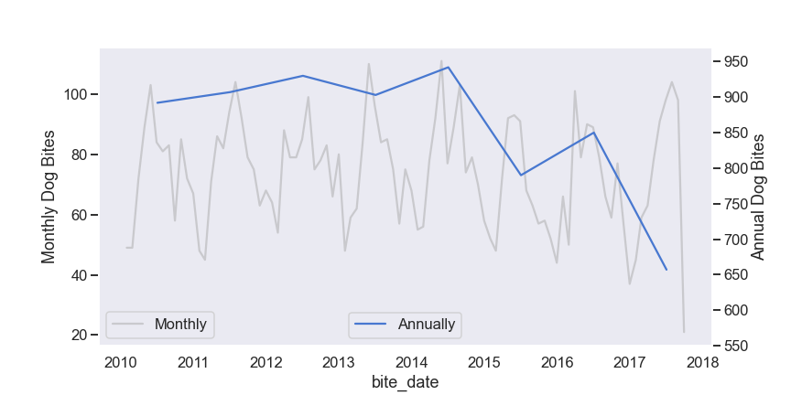
Despite recent cases, Dog Bites are trending down

Slide 4
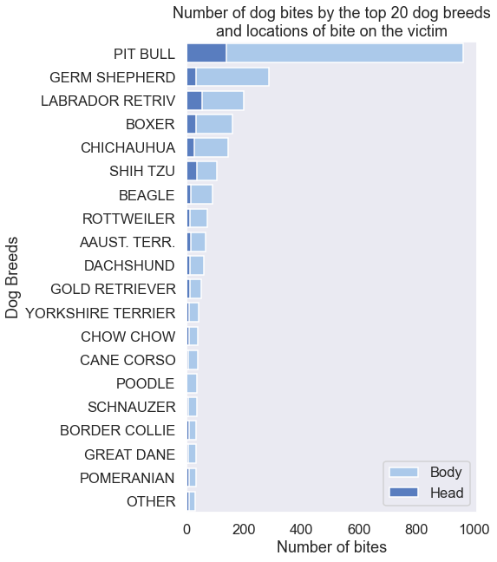
To reduce risk, exercise caution around certain breeds
But it’s not just big dogs…

Slide 5

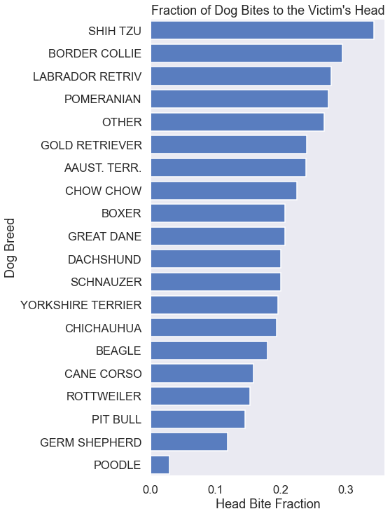



They may be cute…
…but smaller dogs have a propensity for biting victims in the head.

Slide 6
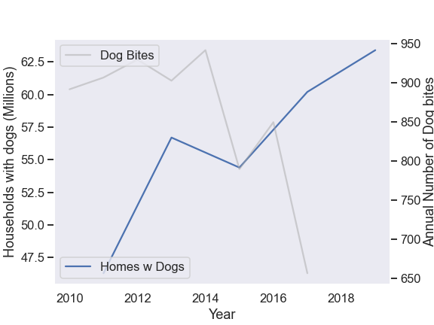
Good news! Bite rate declining in spite of growing number households with dogs
From American Pet Products Association National Survey

Slide 7
Residents of Louisville
Dog bite incidents are on the decline in spite of an increase in the number of households with dogs.
To continue this trend ensure that that your pets:
Are well fed
Are well trained
Get plenty of exercise
Get the opportunity to socialize, especially when young
To reduce risk exercise caution when encountering Pit Bulls and German Shepherds
The chance of getting rabies following a dog bite is only 0.014%!

Slide 8
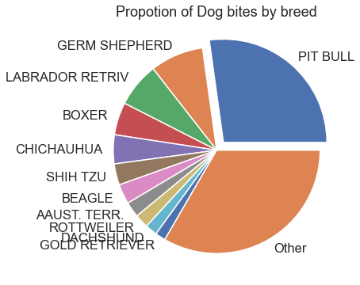
To reduce risk, exercise caution around dangerous breeds
The chance of getting rabies following a dog bite is only 0.014%!

